Slide 1
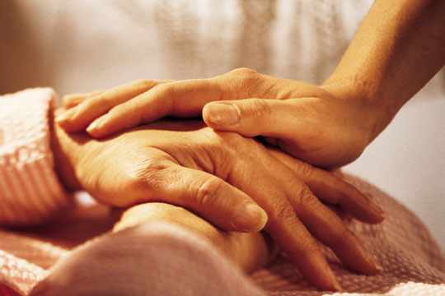
Discussion of Readings. Interventions.
What are the needs met through the act of bullying? Can they be met otherwise?
Supporting the development of a caring attitude
What are the causes of bullying?

Slide 2
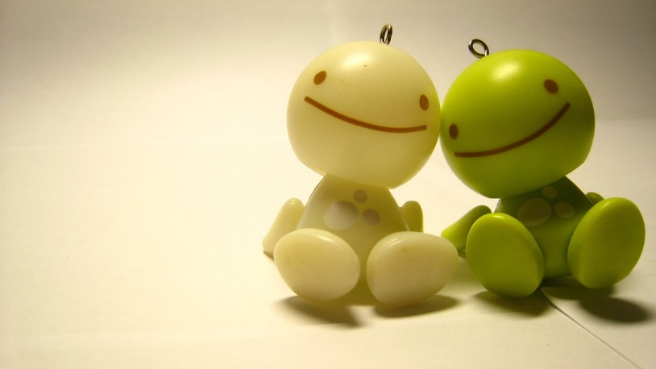
Interventions
"Victims who are friends with a nonvictimized peer are less likely to internalize problems as a result of the victimization—for example, being sad, depressed, or anxious (Hodges, Boivin, Vitaro, & Bukowski, 1999)"
“Victimization and scapegoating were highest in groups with an autocratic atmosphere, with a dominant group leader and a strongly hierarchical structure. Victimization was lowest in groups with a democratic atmosphere, where relationships with group leaders were more egalitarian and cohesive”

Slide 3
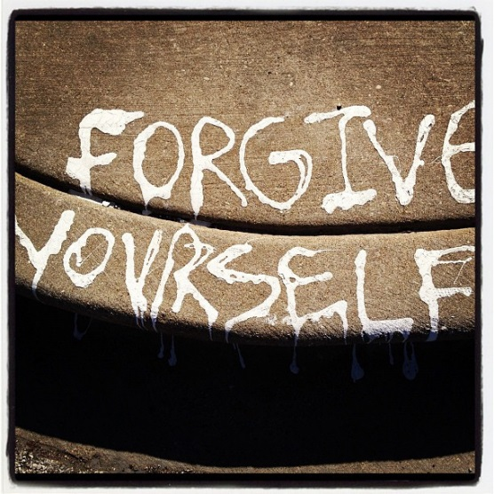
Interventions
“Students are asked to reflect on the type of person they want to be […] Self-restitution is a multi-process task that involves fixing (restoring) the self to the person one wants to be"
“I agree it is important to meet your need but the way you met it hurt someone else"

Slide 4
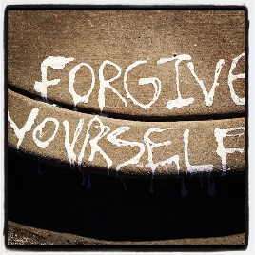
Other ideas ?
Interventions
“Students are asked to reflect on the type of person they want to be […] Self-restitution is a multi-process task that involves fixing (restoring) the self to the person one wants to be"
“I agree it is important to meet your need but the way you met it hurt someone else"
"Victims who are friends with a nonvictimized peer are less likely to internalize problems as a result of the victimization—for example, being sad, depressed, or anxious (Hodges, Boivin, Vitaro, & Bukowski, 1999)"
“Victimization and scapegoating were highest in groups with an autocratic atmosphere, with a dominant group leader and a strongly hierarchical structure. Victimization was lowest in groups with a democratic atmosphere, where relationships with group leaders were more egalitarian and cohesive”

Slide 5
What are the needs that are met by hurting another person?
Can I hurt her too? It is my favorite thing (Elementary School Student)
SEL Skill:
Feeling good without putting self and others down
Lack of SEL skills
Bullying

Slide 6
Caring for self
Caring for others
Caring for animals
Caring for objects
Caring for ideas

Slide 7
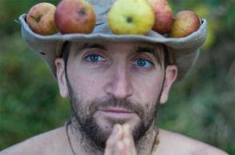
“If we grew our own food, we wouldn't waste a third of it as we do today. If we made our own tables and chairs, we wouldn't throw them out the moment we changed the interior decor. If we had to clean our own drinking water, we probably wouldn't contaminate it”
Mark Boyle
If you don’t own a plasma screen TV, people think you’re an extremist
School projects to develop a caring attitude ?

Slide 8
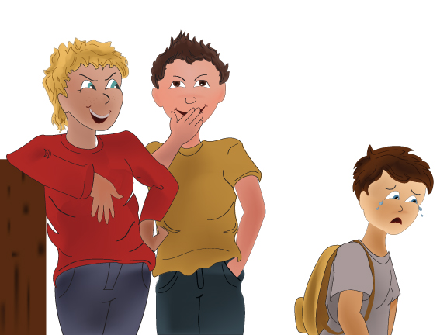
…
Aggression at home
…
…
…
…
http://www.louairahal.net/GroupMind/index.html

Slide 9
Bullying: Definition and Causes
Blaming the victim Ideology
Fear of being bullied
Popularity in peer culture
“Bullying happens when a student is exposed repeatedly and over time to negative actions on the part of one or more students” (Yerger and Gehret, 2011)
Popularity in peer culture
Inconsistency in Discipline
Aggression Modeled at Home
Morality Crisis

Slide 10
Use of punishments and rewards
Teaches that authority can manipulate behaviour
Teaches us to display the behaviour desired by authority
When rewards and punishments are used inconsistently, children learn that authority has the absolute power.

Slide 11
Morality Theory: Blaming the Victim Ideology, Legitimizing Aggression
Boys: Higher moral reasoning correlated with higher aggression. Why? Schonert-Reichl, 1999
!
“Blaming the victim ideology”: tendency to believe that those who are bullied deserve to be bullied
“two out of three students report that teachers handle the problems of bullying inadequately”
Newman-Carlson and Horne, 2004

Slide 12
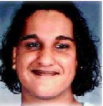
Use of ‘Bullying’
Erasing Misogyny
Erasing Racism
'Bullying' is important, yes, but it is a vague term that glosses over the structural reasons for why it happens, like race/gender/class/ability. Fazeela Jiwa, Former BC high school teacher
http://www.vancouverobserver.com/blogs/feminista/why-isnt-anyone-talking-about-misogyny-involved-amanda-todds-life-and-death

