Slide 1
Understanding Problem Behavior
Problem behavior as means for gaining recognition
Problem behavior due to poor emotional regulation
Importance of organized, structured environments
Teacher modeling: ‘Children see, children do’
Louai Rahal, January 2015

Slide 2
Sense of Humor
“A well-developed sense of humor will do much to prevent burnout among professionals working with challenging students”
“Humor provides a successful outlet for stress and prevents teachers from taking failures or themselves too seriously” (THEY SHOULD STILL LEARN FROM FAILURE)
FLEXIBILITY
“Teachers need to refrain from insisting on ‘the way they’ve always done it’ ”

Slide 3
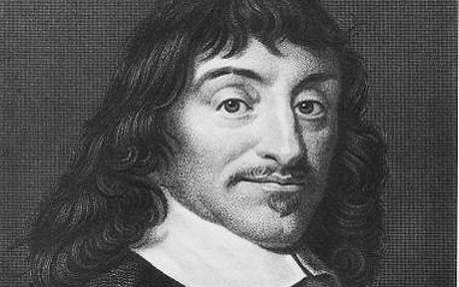
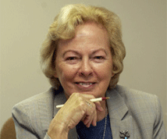
DUALISME
EXISTENTIALISME
“Je mets Babinee en colère, donc j’existe”
“Je pense donc j’ existe”
“Je la fait sourire, donc j’existe”
“When the infant’s cry produces a response, his or her existence is confirmed”
My Problem Behavior Makes You Angry/Irritated, It Produces A Response, It Confirms My Existence.

Slide 4
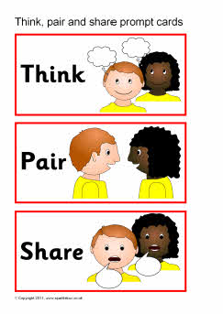
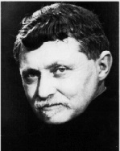
1. An instance where you felt good by teasing someone
2. An instance when you saw someone feeling better (uplifted, motivated, encouraged) because of something you said
3. An instance when you felt ‘invisible’ and being totally ignored.
“When I am with someone who is ‘indisponible’, I am conscious of being with someone for whom I do not exist; I am thrown back on myself” (Gabriel Marcel)

Slide 5
Strategy: Ignoring Problem Behavior ?
Risk: Student might respond to being ignored by increasing the problem behavior
Confirmation: Confirming the student’s existence by being receptive and responsive to their presence, to their positive behaviors, this does not mean that you are being unresponsive to the problem behavior

Slide 6
“A teacher who understands that Bob is trying to achieve some recognition grants a positive motive for his unacceptable act” (Noddings)
“By letting him know –explicitly or implicitly- that she sees in him a better person who is better than his acts, she confirms that better person” (Noddings)

Slide 7
Restorative Justice
Problem behavior causes harm to the community
Teacher and Student brainstorm a plan of action that allows the student to restore her belongingness to the community
Restorative behavior brings back the student to the community
Think about a situation
Think about a situation that worries you.
Apply confirmation and restorative justice to address the situation.

Slide 8
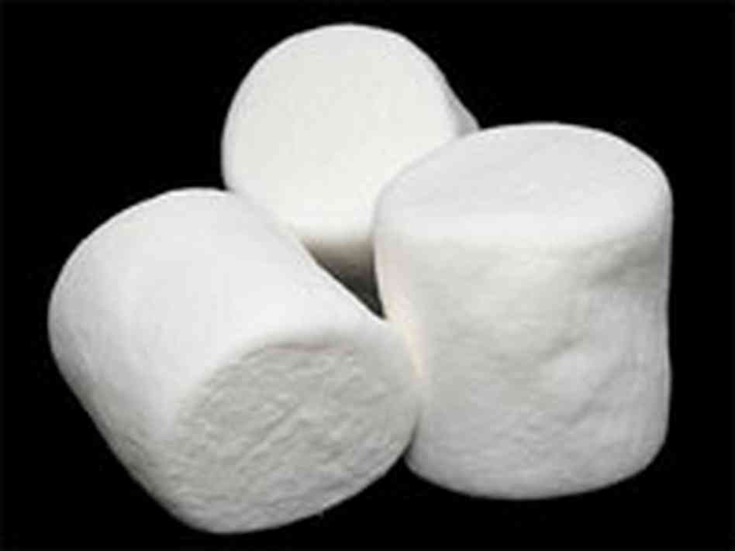
Sandwich Feedback on behavior
Highlight positive qualities
Offer clear, specific suggestions on how to move towards a better behavior
End with Encouragement
Marshmellow Experiment:
“it is one thing to know how to act, and an entirely different thing to act correctly” (??)
Not all students can practice impulse regulation and emotional regulation
Give students the opportunity to develop emotional regulation
Monitor Progress and Give Feedback
practice in pairs

Slide 9
Can I hurt her too? It is my favorite thing (Elementary School Student)
SEL Skill:
Feeling good without putting self and others down
Other SEL skills to prevent problem behavior?
https://louaiblog.wordpress.com/2014/05/14/can-we-prevent-bullying-a-reflection-on-a-lecture-given-by-dr-debra-pepler-at-sfu/

Slide 10
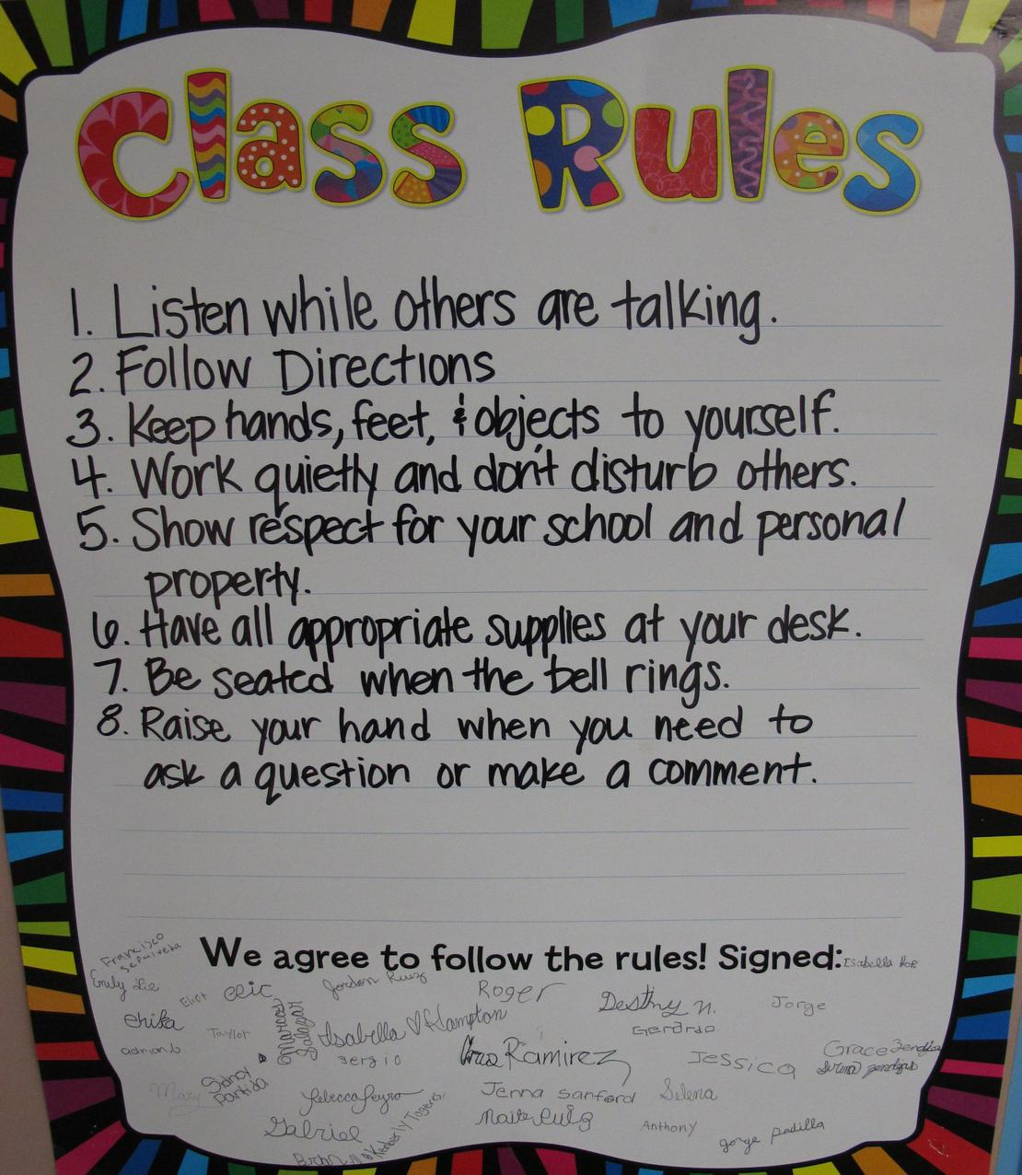
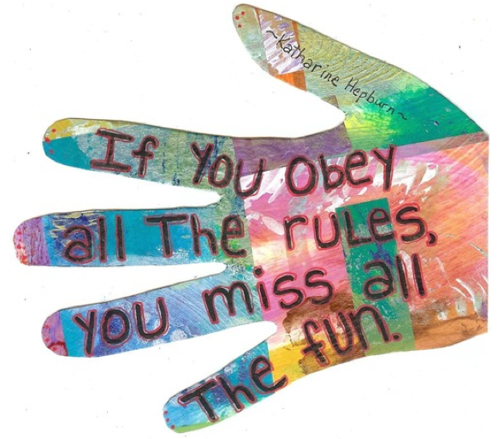
Preventing problem behavior:
Organized, predictable classroom environments.
Efficiently calling students’ attention at the beginning of class/ after break
Using visual aids to display instructions for a group activity
Strict Undemocratic Authority: “It frightens the weak, but arouses resistance in the strong and imparts a special charm of strength, boldness, and challenge to the breaking of the rules”

Slide 11
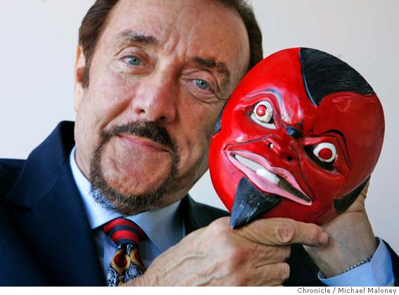
Zimbardo:
Behavior is a function of both the subject and the situation
Milgram Experiment
Stanford Prison Experiment
The Heroic Imagination Project
Lucifer Effect
Noddings:
Shared Responsibility

