Slide 1
Unit 3: Supportive Relations in the Classroom

Slide 2
What is the role of teachers?
https://www.youtube.com/watch?v=SFnMTHhKdkw

Slide 3
What he is saying does not make sense
BUT I THINK I KNOW WHAT HE IS TRYING TO SAY
EMPATHY

Slide 4
What makes you better understand a teacher, the clarity of their explanations or your ability to empathize with them? THINK/PAIR/SHARE
“To learn, students empathically recognize the teacher’s actions, thoughts and goals […] For example, to learn how to do a math problem, the students in the class must understand the goal of the exercise, and be able to relate that goal to the teachers’ actions and thoughts […] Using their own experience as a platform, the students struggle to discern and reconstruct the teacher’s oftentimes invisible mental actions in their own mind” (Immordino Yang, 2009)

Slide 5
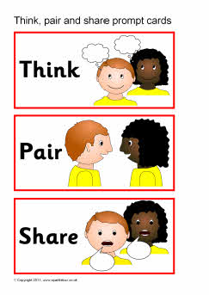
Benefits:
Assessment for learning
Safe for risk taking
Risks:
On person dominates
Pair can go ‘off topic’

Slide 6
Building relations with students
Make time for positive interactions
Banking Time
Consistency
Attachment relations require consistency
Responsive Caring
If the cared for does not ‘accept’ our caring, we are still not in a caring relation
‘One day you will thank me’
Attentiveness
‘I can read your signs’

Slide 7
Love … requires discipline, concentration, patience, faith, and the overcoming of narcissism. It isn't a feeling, it is a practice (Erich Fromm)
"I love in you everybody, I love through you the world” (Erich Fromm)

Slide 8
READING ACTIVITY
10
Student-Teacher Interaction
Promotes trust and a positive relations
DOES NOT promote a positive relation
3

