Slide 1
Unit 1: Classroom Environments
Where We’ve Been and Where We’re Going
Louai Rahal, 2015

Slide 2
Menu du Jour
Game: Name Chain
  Evaluation of the game
Reading: Class constitutions, one minute managers.
Growth Mindset: Marva Collins.
From classroom management to classroom community.

Slide 3
Name Chain
I am
  Listening Louai
  A…. Anne
  B…. Babinee
  C…. Chelsea

Slide 4
Alternatives to the name chain
What’s in a name
  Who chose your name for you?
  What is the meaning of your name?

Slide 5
Benefits and Risks of creating class constitutions with students
What are the benefits of creating classroom constitutions?
What could go wrong?

Slide 6
THEORY
PRACTICE
Democratic Authority
How can I turn my authority into a democratic authority?
Authority based on a social contract
Authority figure and people create the social contract
Authority figures applies the social contract
How can I turn create a social contract?
Class constitutions
‘How can we improve our class environment?’
Informal conversations

Slide 7
Reflection
Non democratic authority (teacher or other authority figure)
  What did you feel?
Democratic authority (teacher or other authority figure)
  What did you feel?
Your Experiences

Slide 8

THEORY
PRACTICE
How can I create a sense of belonging to my class?
How can I create a sense of autonomy and competence?
SELF
DETERMINATION
THEORY
Autonomy
Belonging
Competence
Appointing managers
Giving choices
Creating opportunities for success
Encouragement + Scaffolding

Slide 9

THEORY
PRACTICE
How can I promote a growth mindset in my classes?
« Je vais être toujours une étudiante et en fait, je ne veux jamais arrêter d’apprendre parce qu’il y a toujours des changements et des découvertes »
Growth Mindset
Nancy Li

Slide 10
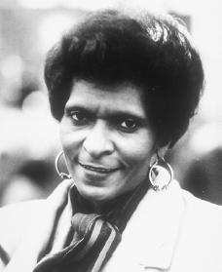
Marva Collins
“Sometimes I don’t like other grown-ups very much because they think they know everything. I don’t know everything. I can learn all the time”
“It’s so hard here. There is no recess. There’s no gym. They work you all day. You have only forty minutes for lunch” (Morley Safer, 60 minutes)
‘Welcome to Success’
“That’s why I like it, because it makes your brains bigger”

Slide 11
Advantages/disadvantages of using rewards
The good deed cheque
Prosocial Behaviour rewarded with cheques
A student would push another student when the teacher is not looking. Same student would display prosocial behavior when teacher is looking.

Slide 12
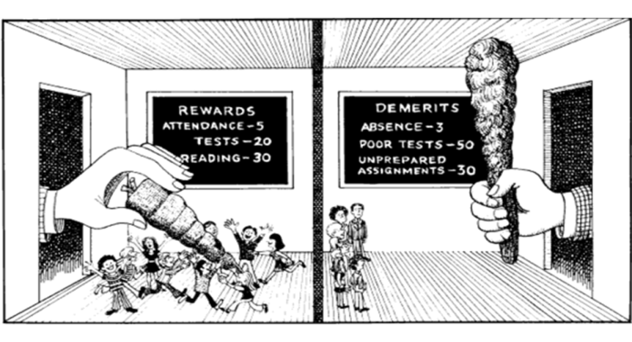

Shifting Paradigms
https://www.youtube.com/watch?v=ZiuAFOv8wvw

Slide 13
What is your goal for your students?
“Do we want to raise compliant, obedient youth who have limited experiences with initiative and creativity or would we rather raise our nation’s youth to be caring, self-disciplined, independent thinkers?” (Freiberg & Lamb, 2009, p. 99).

Slide 14
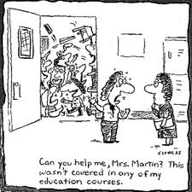
Teacher Burnout, #1 reason for leaving the profession

